Slide 1
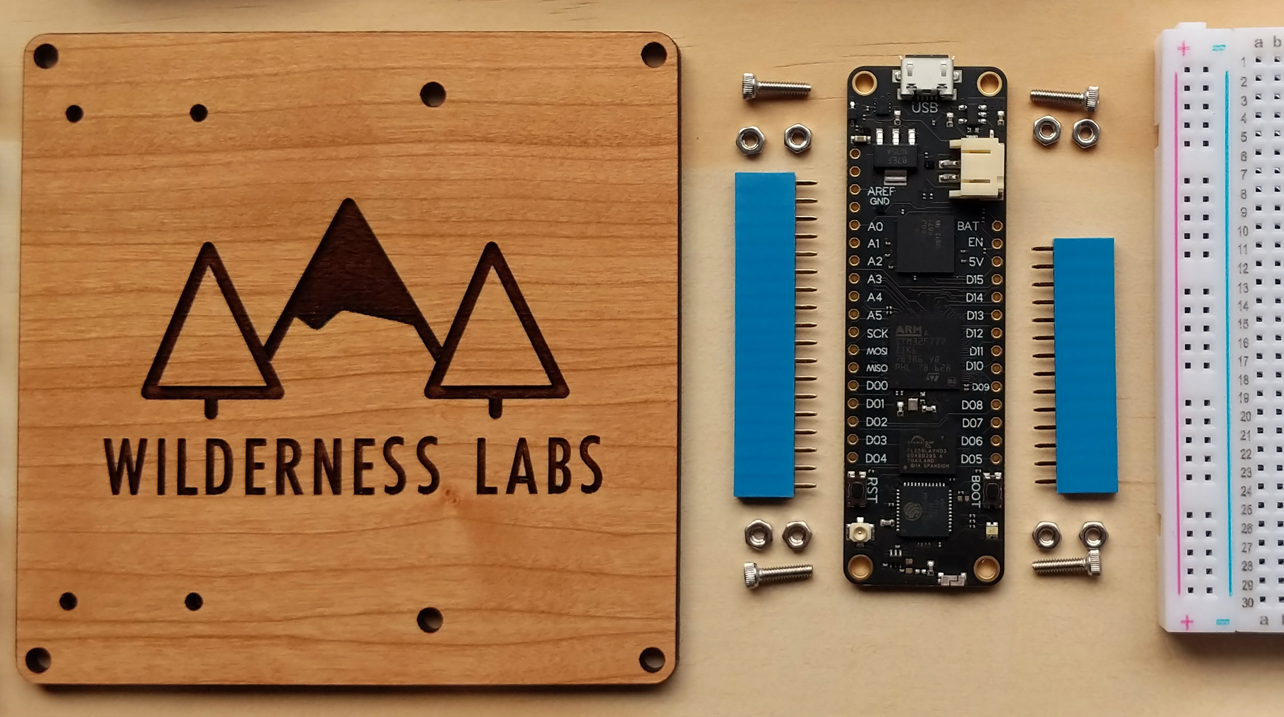

Develop IoT Solution using Meadow &

Slide 2

Hello,
I am Yunus
Name : Muhammad Yunus
Email : yunusmuhammad007@gmail.com
Phone : 083870713580
job :
Oprekers

Slide 3
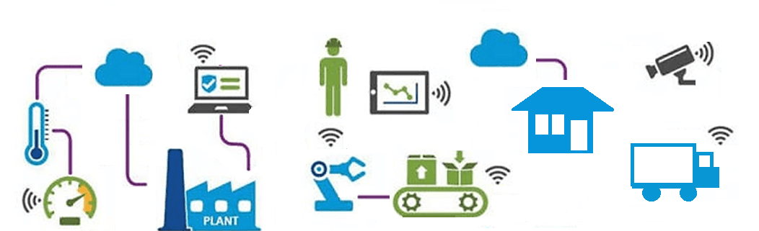
IoT ?

Slide 4
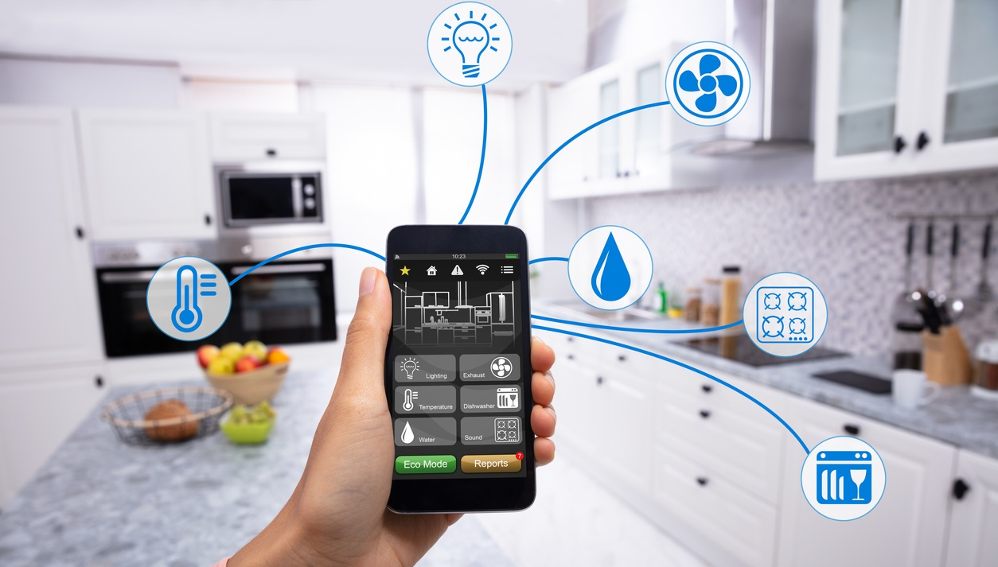
Smart Home ?

Slide 5
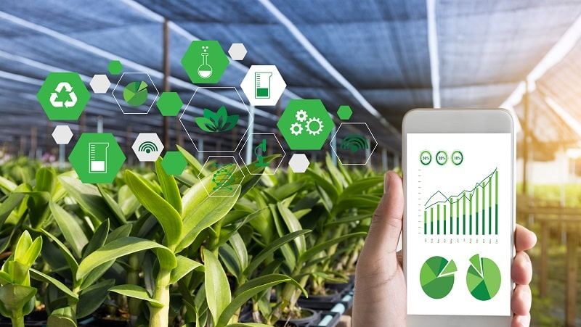
Smart Farming ?

Slide 6
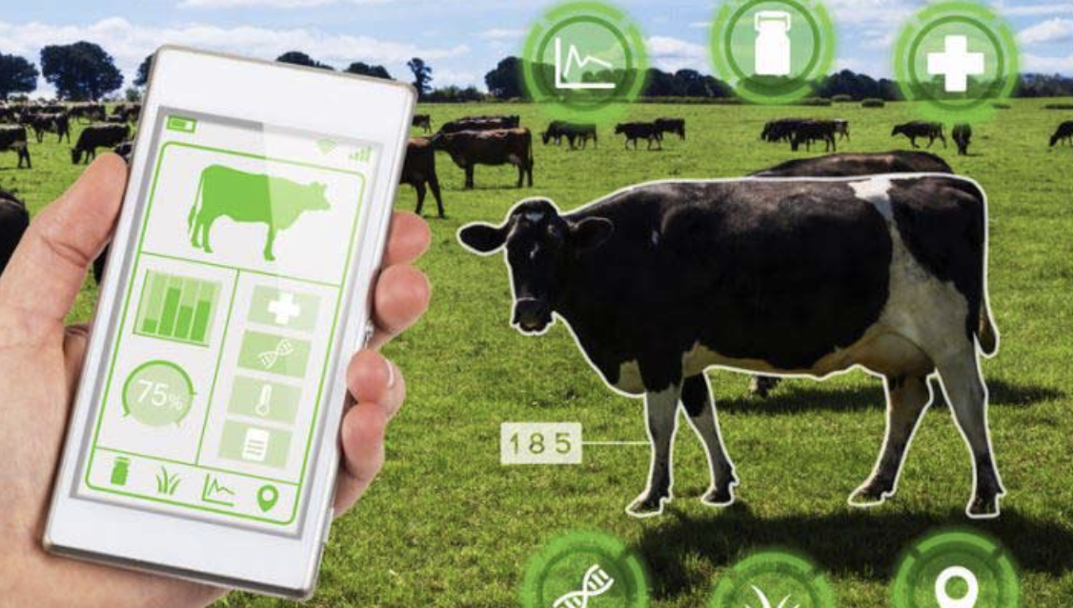
Smart Livestock ?

Slide 7

Industrial Monitoring & Control ?

Slide 8
Perangkat IoT yang kita tau ?

Slide 9
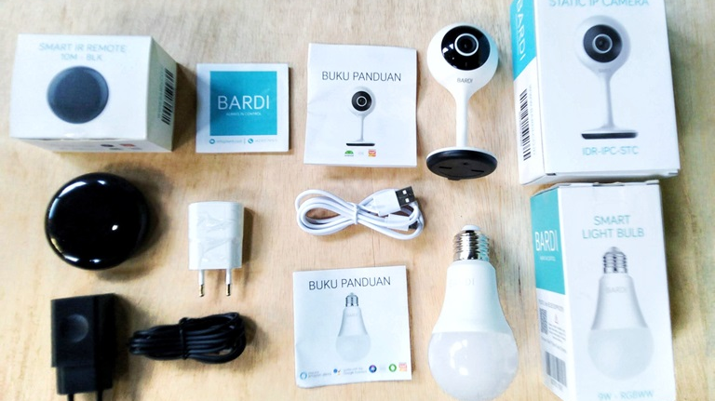
BADRU

Slide 10
Tapi itu produk jadi...
Bisa kita bikin sendiri ?

Slide 11
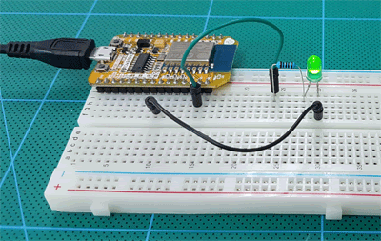
Dimulai dari
BLINK

Slide 12
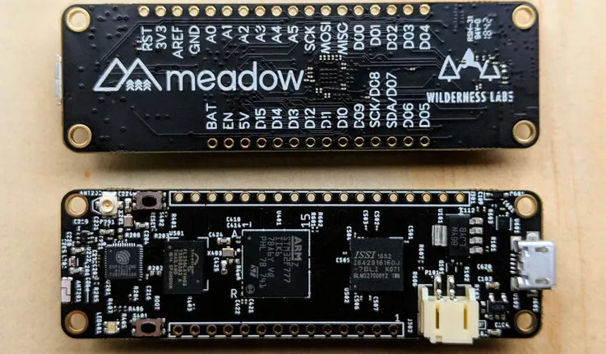
Tapi running Blink di yang ini agak mahalan dikit...

Slide 13
Arsitektur Sederhana
Sistem IoT

Slide 14
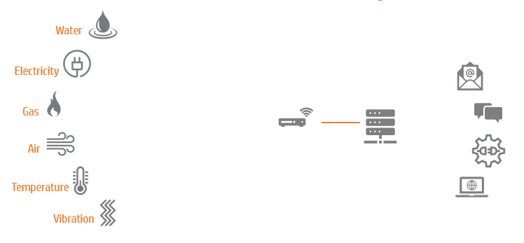

Email
SMS/Telegram/Twitter
API
Web / Mobile App
Sensor
Device
Gateway
Server
Aplikasi

Slide 15
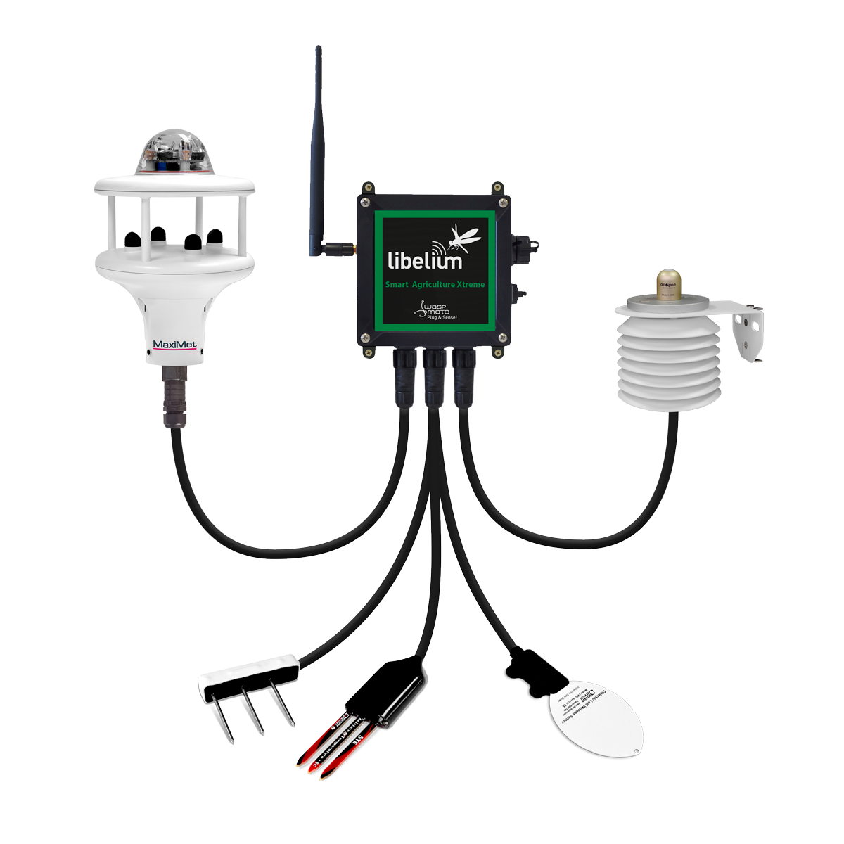
Email
weather conditions,
light and radiation levels,
soil morphology,
fertilizer presence,
frost prevention
SMS/Telegram/Twitter
API
Web Dashboard/ Mobile App
Waspmote Plug & Sense! Smart Agriculture Xtreme
Sensor
Device
Gateway
Server
Aplikasi

Slide 16
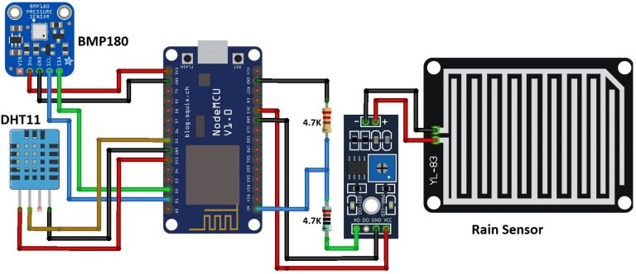
sensor tekanan udara
sensor suhu dan kelembaban
sensor droplet hujan
Email
SMS/Telegram/Twitter
API
Web Dashboard/ Mobile App
IoT Node berbasis NodeMCU ESP8266
Sensor
Device
Gateway
Server
Aplikasi

Slide 17
connectivity
Tipe Koneksi Device → Gateway :
- WiFi
- Bluetooth
- Celullar (2G/3G/4G)
- Ethernet (Kabel)
- Zigbee
- LoRa
Sensor
Device
Gateway
Server
Aplikasi

Slide 18
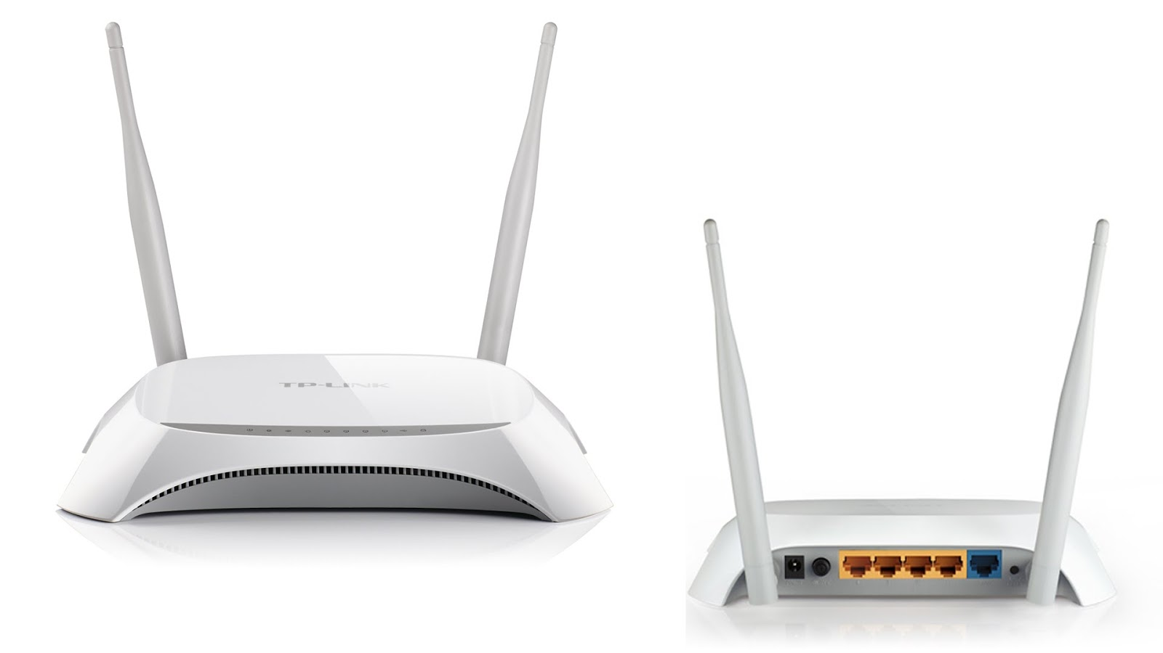
Sinyal WiFi
Gateway dengan koneksi WiFi
WiFi AP (Access Point)
Sensor
Device
Gateway
Server
Aplikasi

Slide 19
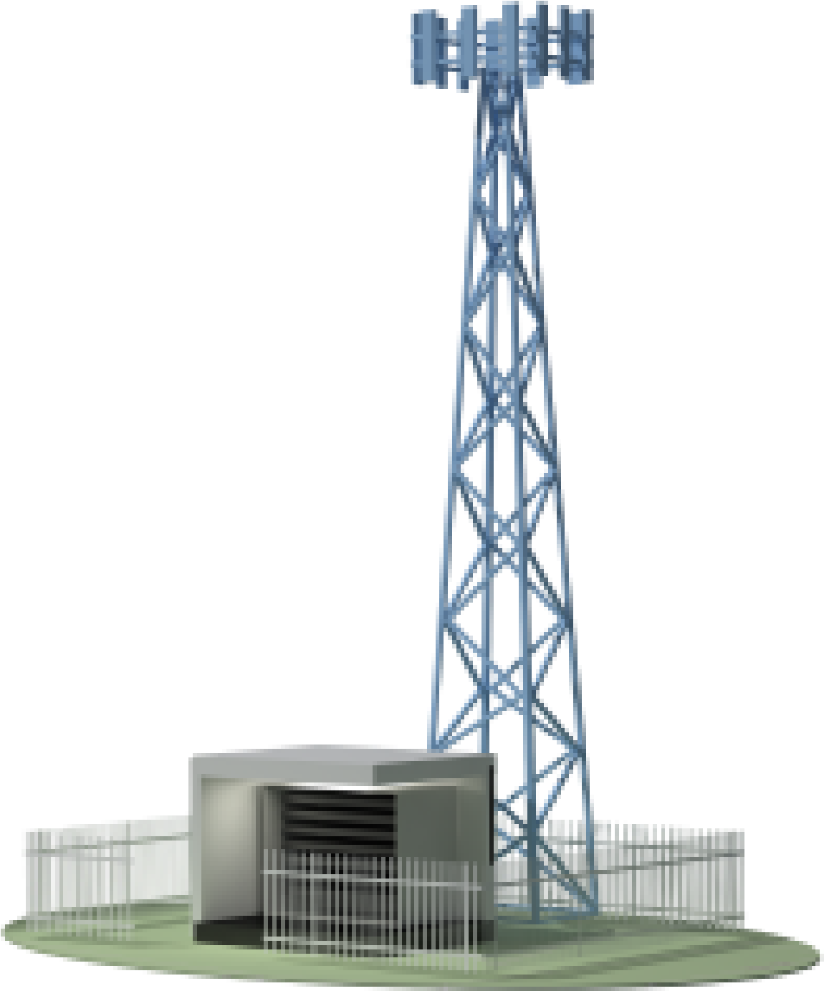
sim card
Sinyal Cellular
Gateway dengan koneksi Cellular
sim card
sim card
sim card
sim card
BTS Cellular
Sensor
sim card
Device
Server
Gateway
Aplikasi

Slide 20
Beragam IoT Platform
- Azure IoT
- Antares
- Thinkspeak
- MyDevice Cayenne
- dll..
internet connetion
Email
SMS/Telegram/Twitter
API
Web Dashboard/ Mobile App
Sensor
Device
Gateway
Server
Aplikasi

Slide 21
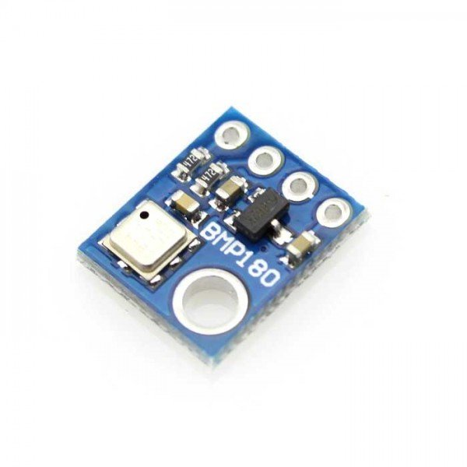
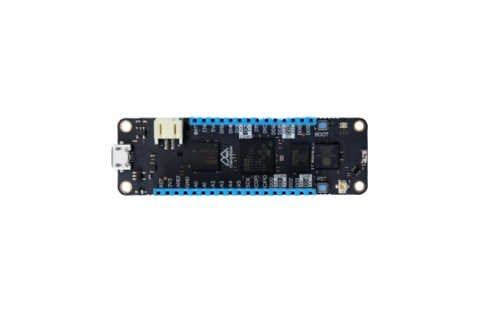
Simple Demo
BMP180
Meadow F7 Micro
Pressure & Temperature
Hands On Code :
https://github.com/Muhammad-Yunus/Meadow-dotNET-Hands-On

Slide 22
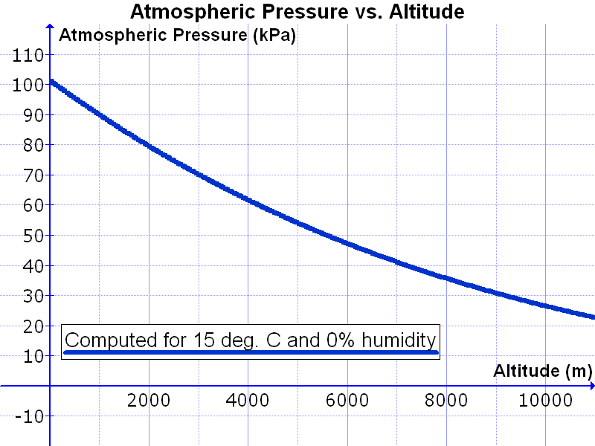
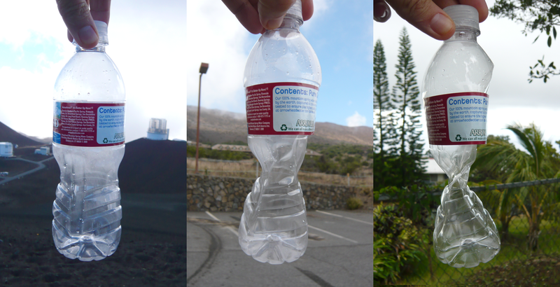
Atmospheric pressure
This plastic bottle was sealed at approximately 14,000 feet (4,300 m) altitude, and was crushed by the increase in atmospheric pressure, recorded at 9,000 feet (2,700 m) and 1,000 feet (300 m), as it was brought down towards sea level.
Variation in atmospheric pressure with altitude, computed for 15 °C and 0% relative humidity.
https://en.wikipedia.org/wiki/Atmospheric_pressure

Slide 23
HTTP POST Sensor Data
Webapp
Dashboard
/api/v1/bmp180/post
Database

Slide 24
Meadow F7 Micro
STM32F7 MCU with ESP-32 co-processor.
WiFi, BLE, 32MB RAM, 32MB Flash.
25 GPIO ports, PWM, I2C, SPI, CAN, UART and integrated LiPo battery charger.

Slide 25
Meadow Platform
Micro Real-Time OS (µRTOS) and full .NET Standard compatible runtime with full-stack IoT APIs for connectivity, power, sleep, and more.
Easily integrate motors, sensors, graphic displays, cameras, and perform industrial control with integrated PID.

Slide 26
